Slide 1
FFT on NN
(Possible topic for 290 &| 400)
Marwin Alejo
2020-20221

Slide 2
An ML challenge…
Existing NNs are expensive
How can it be utilized for daily ubiquitous computing?
  Miniaturization/tweaking of soft-architectures aren’t enough
  Computing platforms must be considered (hardware – comp.arch.)
  NN on frequency-domain – promising research (rapidly growing)
    As replacement for NNs on:
      CNN or GAN or ViT for CVs
      Transformers for NLP
        Because they’re expensive.
        Image conv is expensive.

Slide 3
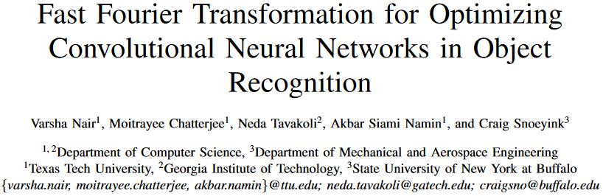
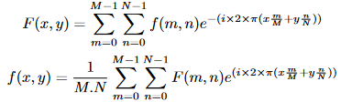
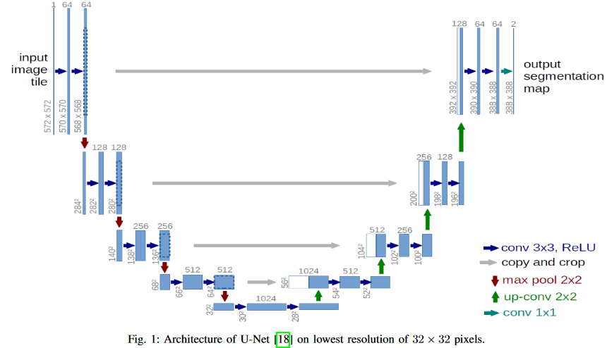
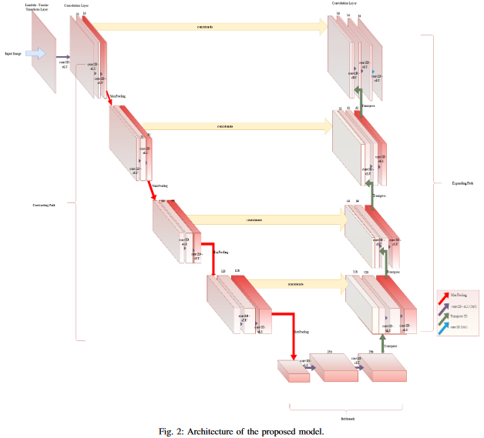
FFT on CNN

Slide 4
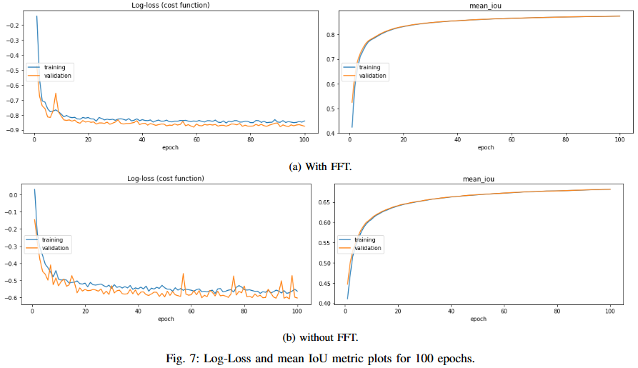
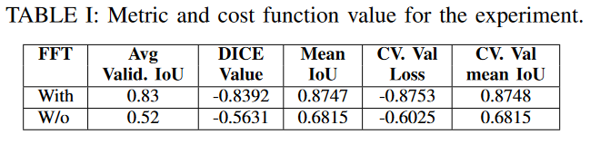
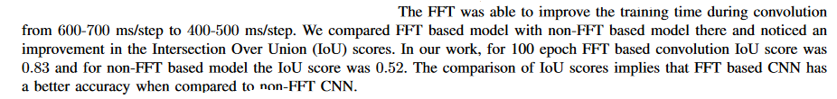
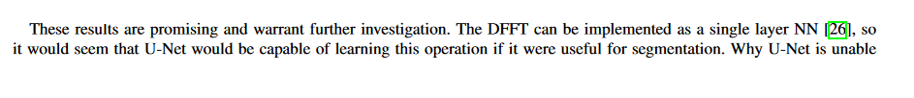
FFT on CNN

Slide 5
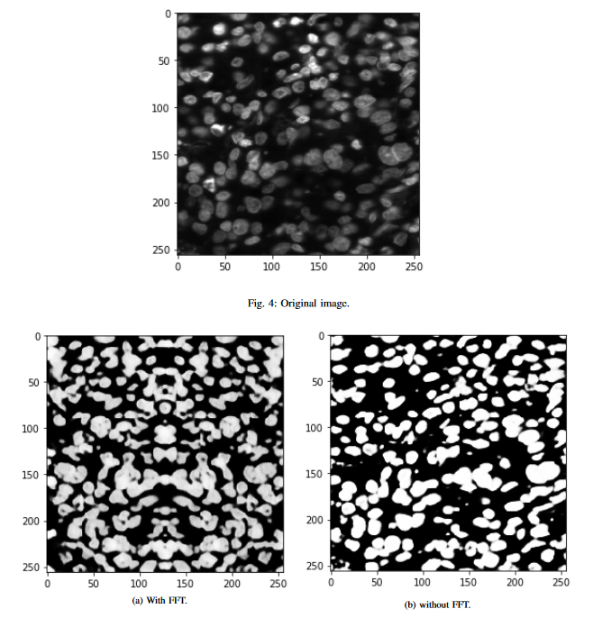
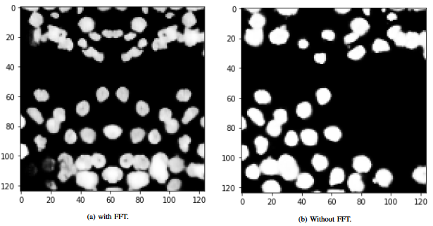
FFT on CNN

Slide 6
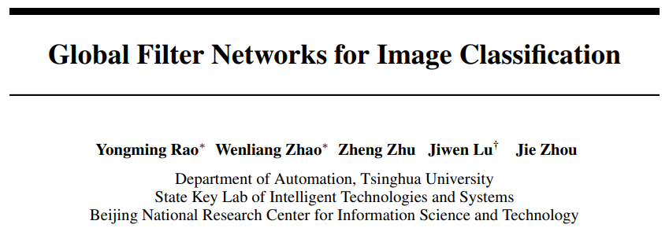
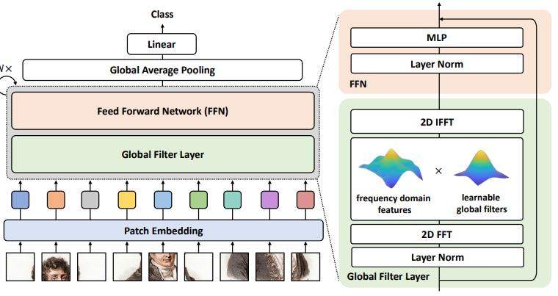
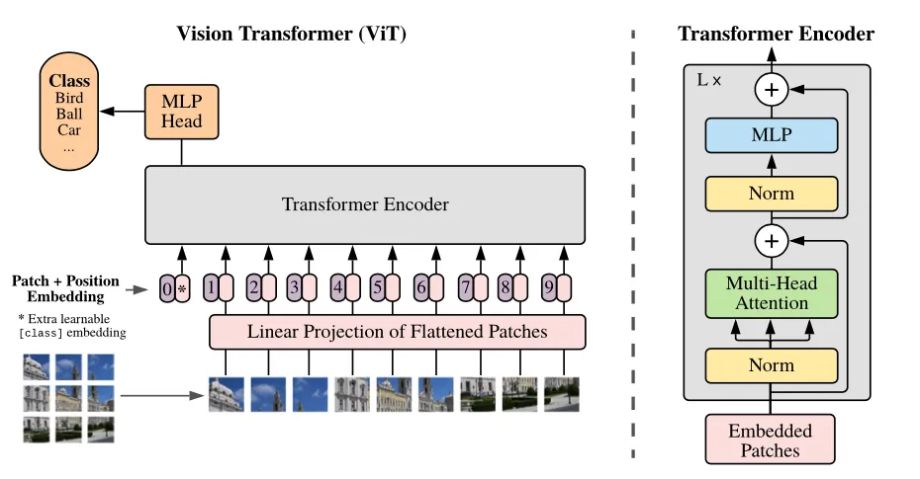
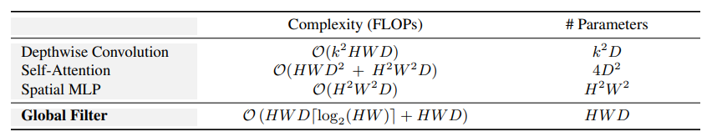
FFT on TransformersNN

Slide 7
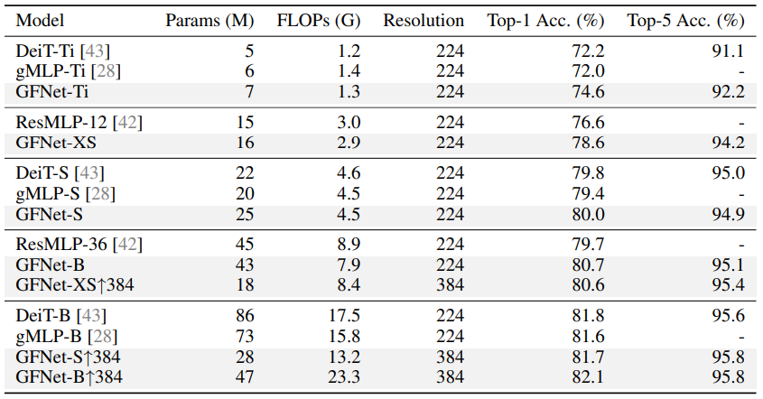
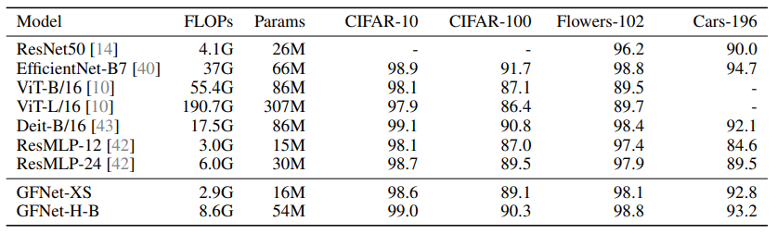
FFT on TransformersNN

Slide 8
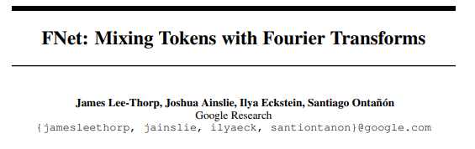
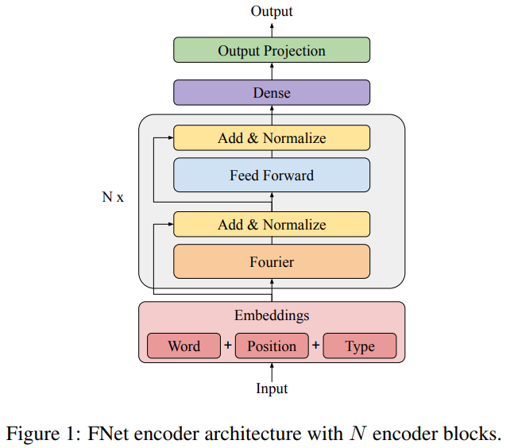
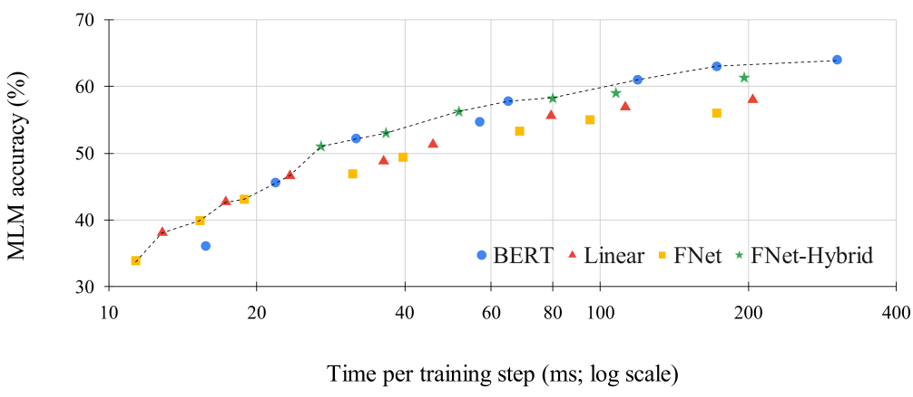
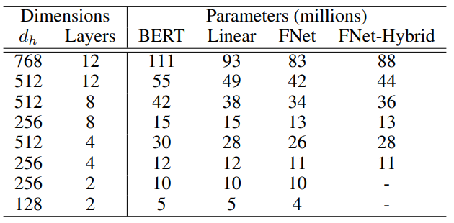
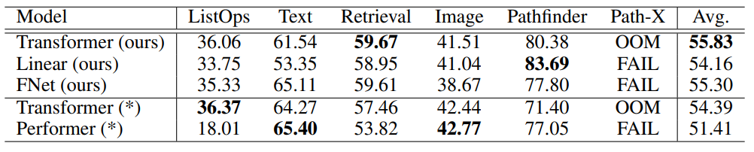
FFT on TransformersNN

